Slide 1
POWER BI CAPSTONE PROJECT
By Adeniyi Adeyemi
C24-05 DA EU

Slide 2
PROJECT INTRODUCTION A hi-Tech case study of Techtronix Innovations

Slide 3
OVERVIEW
Techtronix innovations, a forefront player in the microchip and robotics industry, is encountering challenges in streamlining its sales strategies, optimizing production planning, and pursuing market expansion.
The company boasts an extensive portfolio that caters to automotive, consumer electronics, and industrial sectors. however, it grapples with demand unpredictability, inventory management inefficiencies, and identifation of profitable market opportunities.

Slide 4
OBJECTIVES
Over the previous year, techtronix innovations has meticulously compiled a dataset encompassing each transaction, encompassing sales data, customer interactions, product specifics, and financial metrics.
AIMS
To use the metrics for an in-depth business performance analysis
Enumerate various trends identification of the metrics above
Insight extraction to inform strategic decisions.

Slide 5
ANALYSIS GOALS
We are to guide techtronix innovations in overcoming its current obstacles through the creation of automated power bi reports with the following metrics:
Sales performance analysis: Uncover sales trends across various product categories, sectors, regions, and timeframes. highlight the best and worst performers
Customer insights: Dive into customer segmentation to reveal purchase patterns, preferences by sector, and geographic distribution. identify the sectors contributing most significantly to sales and profitability
Inventory optimization: Evaluate inventory management against sales figures to pinpoint production planning mismatches. propose methods to align production with market demands better
Profitability analysis: Analyze the profitability across different product categories, considering sales revenue and production costs. point out products with high margins and suggest cost-reduction strategies
Market expansion opportunities: Analyze sales and customer data to discover new markets for expansion, emphasizing regions and sectors with untapped potential.

Slide 6
KEY PERFORMANCE INDICATORS (KPI’s)
Revenue MTD $22,167,002
Production cost
$4M
Total Profit
$53M
Total Revenue
$252M
Total Qty Sold
501K
Profit MTD
$4,522,687

Slide 7
INSIGHTS
Microchip brings the highest revenue of $97m while Sensor is the least revenue generating of $76M

Slide 8
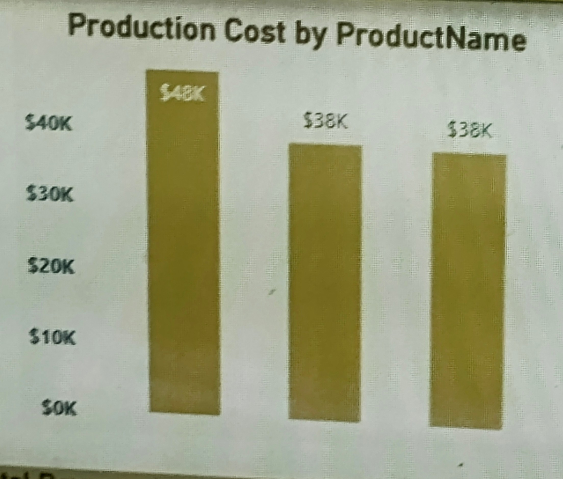
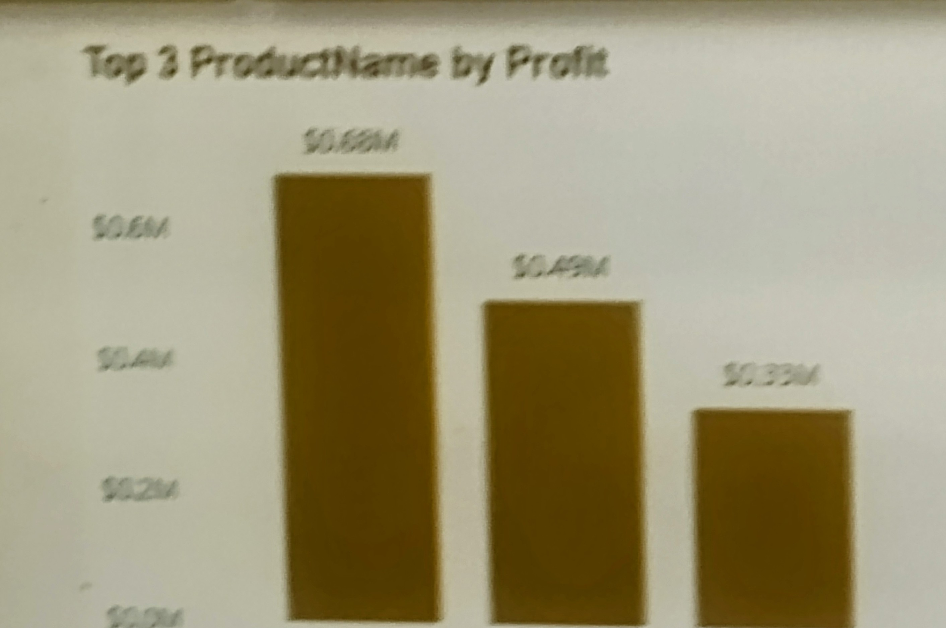
INSIGHTS
Looking at the two charts ,we can see that Product_1100 is the highest most expensive product to produce with production cost of $47,704 with the 3rd highest total profit of $333,022
While product_ 1469 which is the 2nd most expensive product gives a total profit of $493,100 as the 2nd highest profit while product 1100 which is the most expensive product having a production cost of $47,704 gave the least profit in the top three products

Slide 9
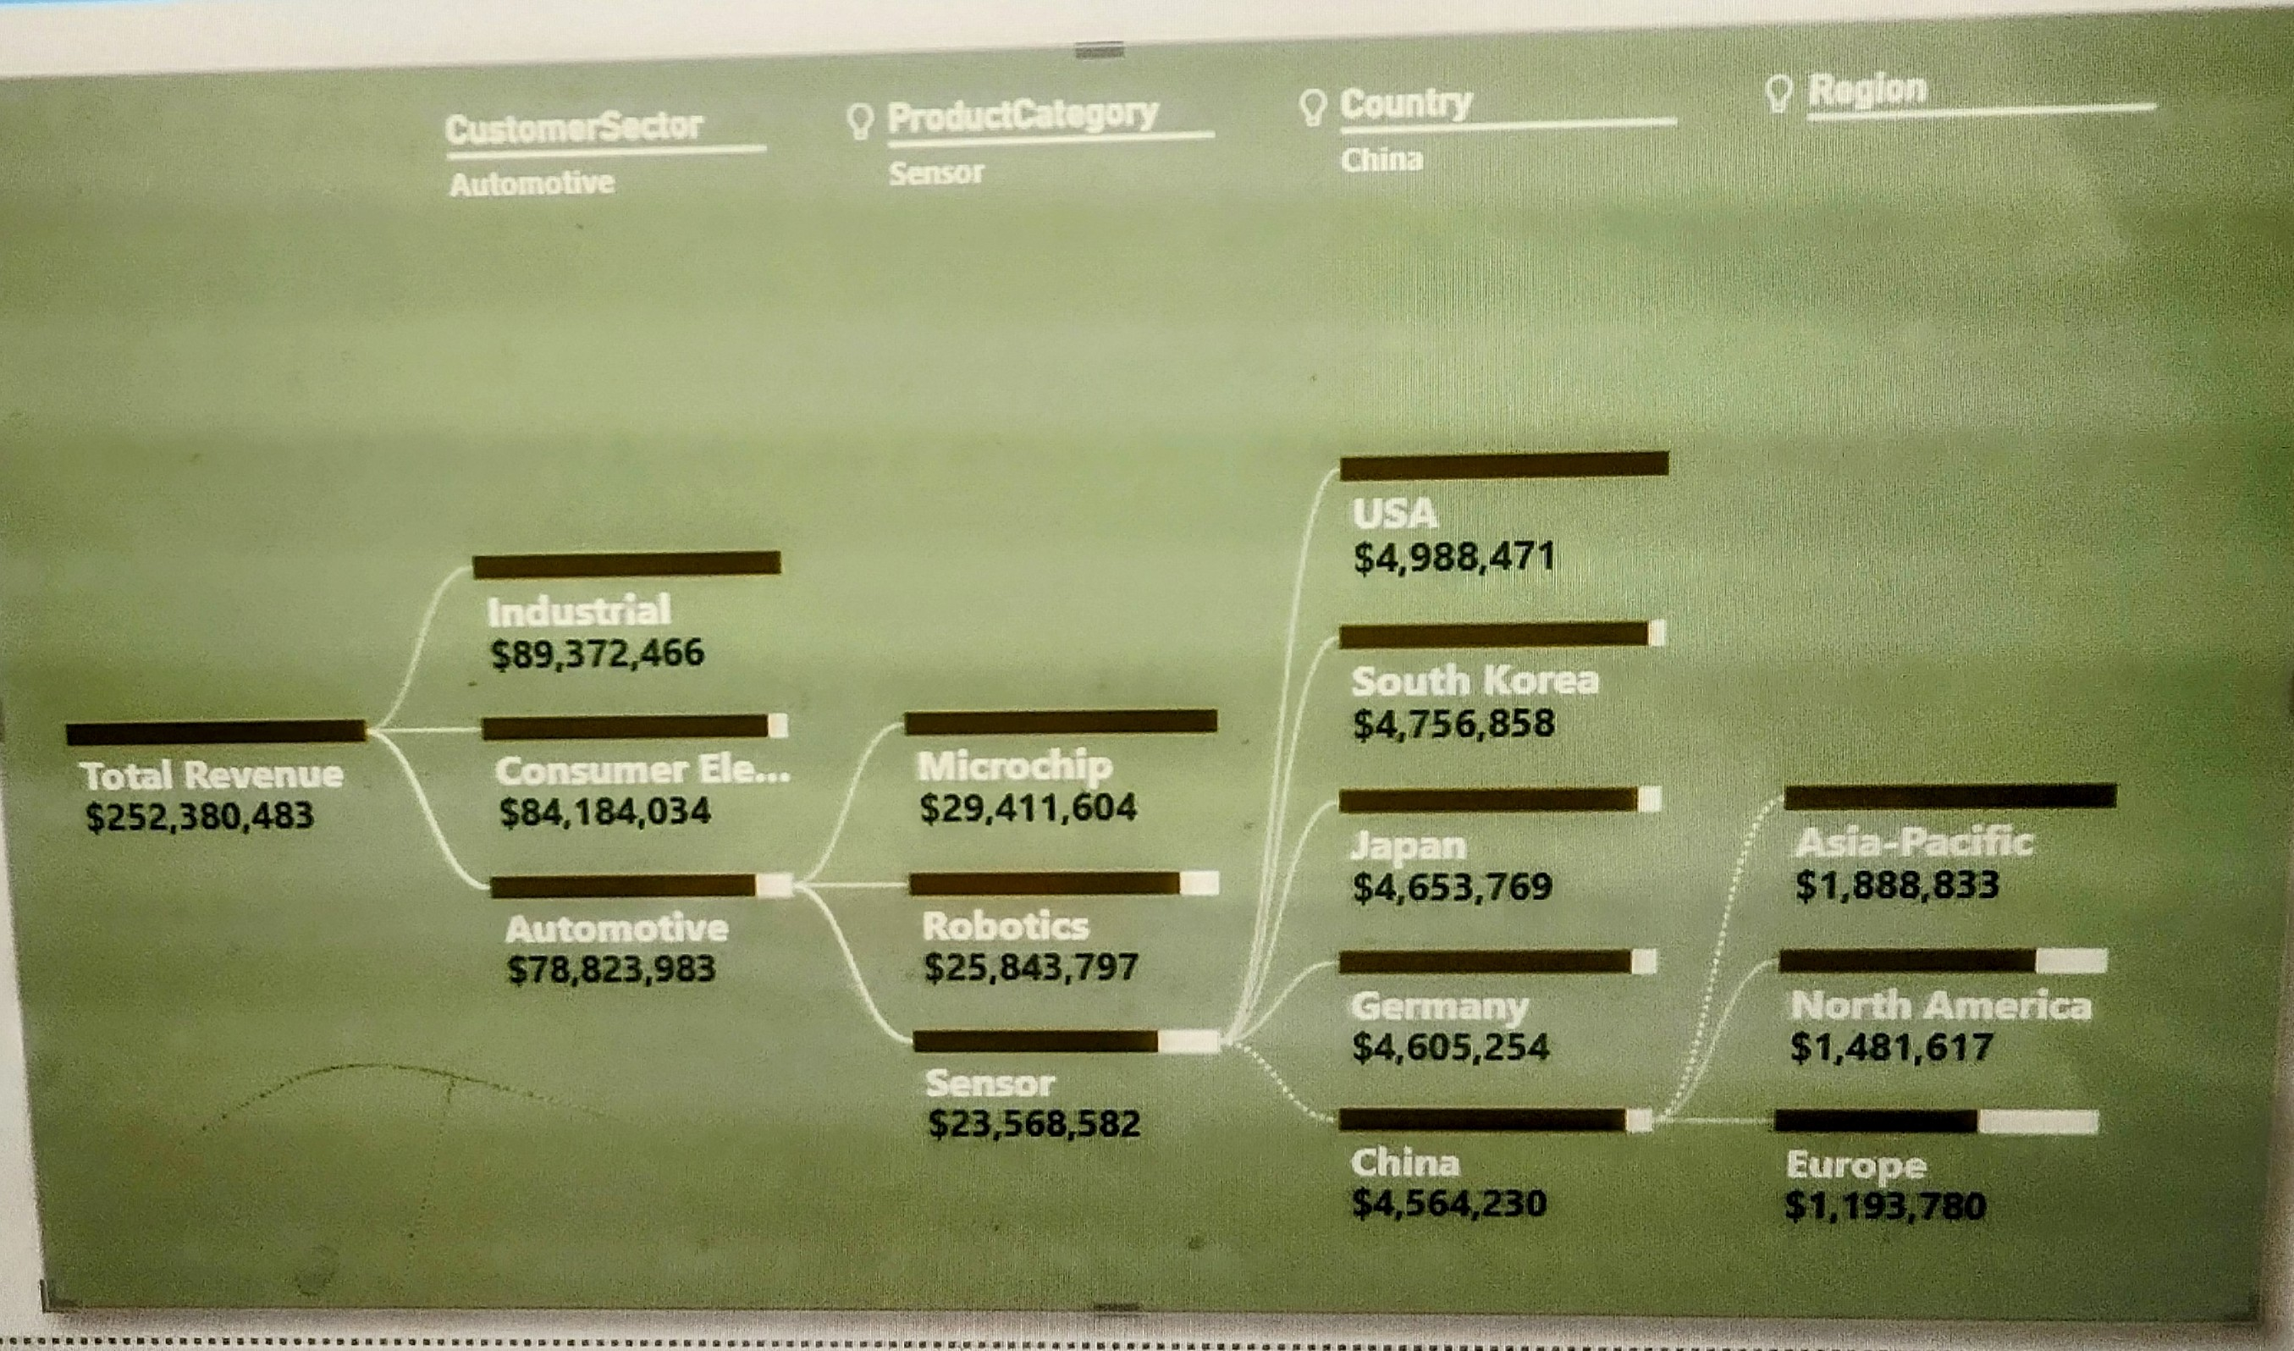
INSIGHTS
The highest revenue came from industrial sector followed by Consumer Electronics and Automotive as the least revenue.
USA recorded the highest in Sensor product category under Automative followed by South Korea and the least revenue is China
Under customer Electronics ,Japan brought in the highest in total revenue with$18,040,733 followed by China and the least being USA generating $16,019,827

Slide 10
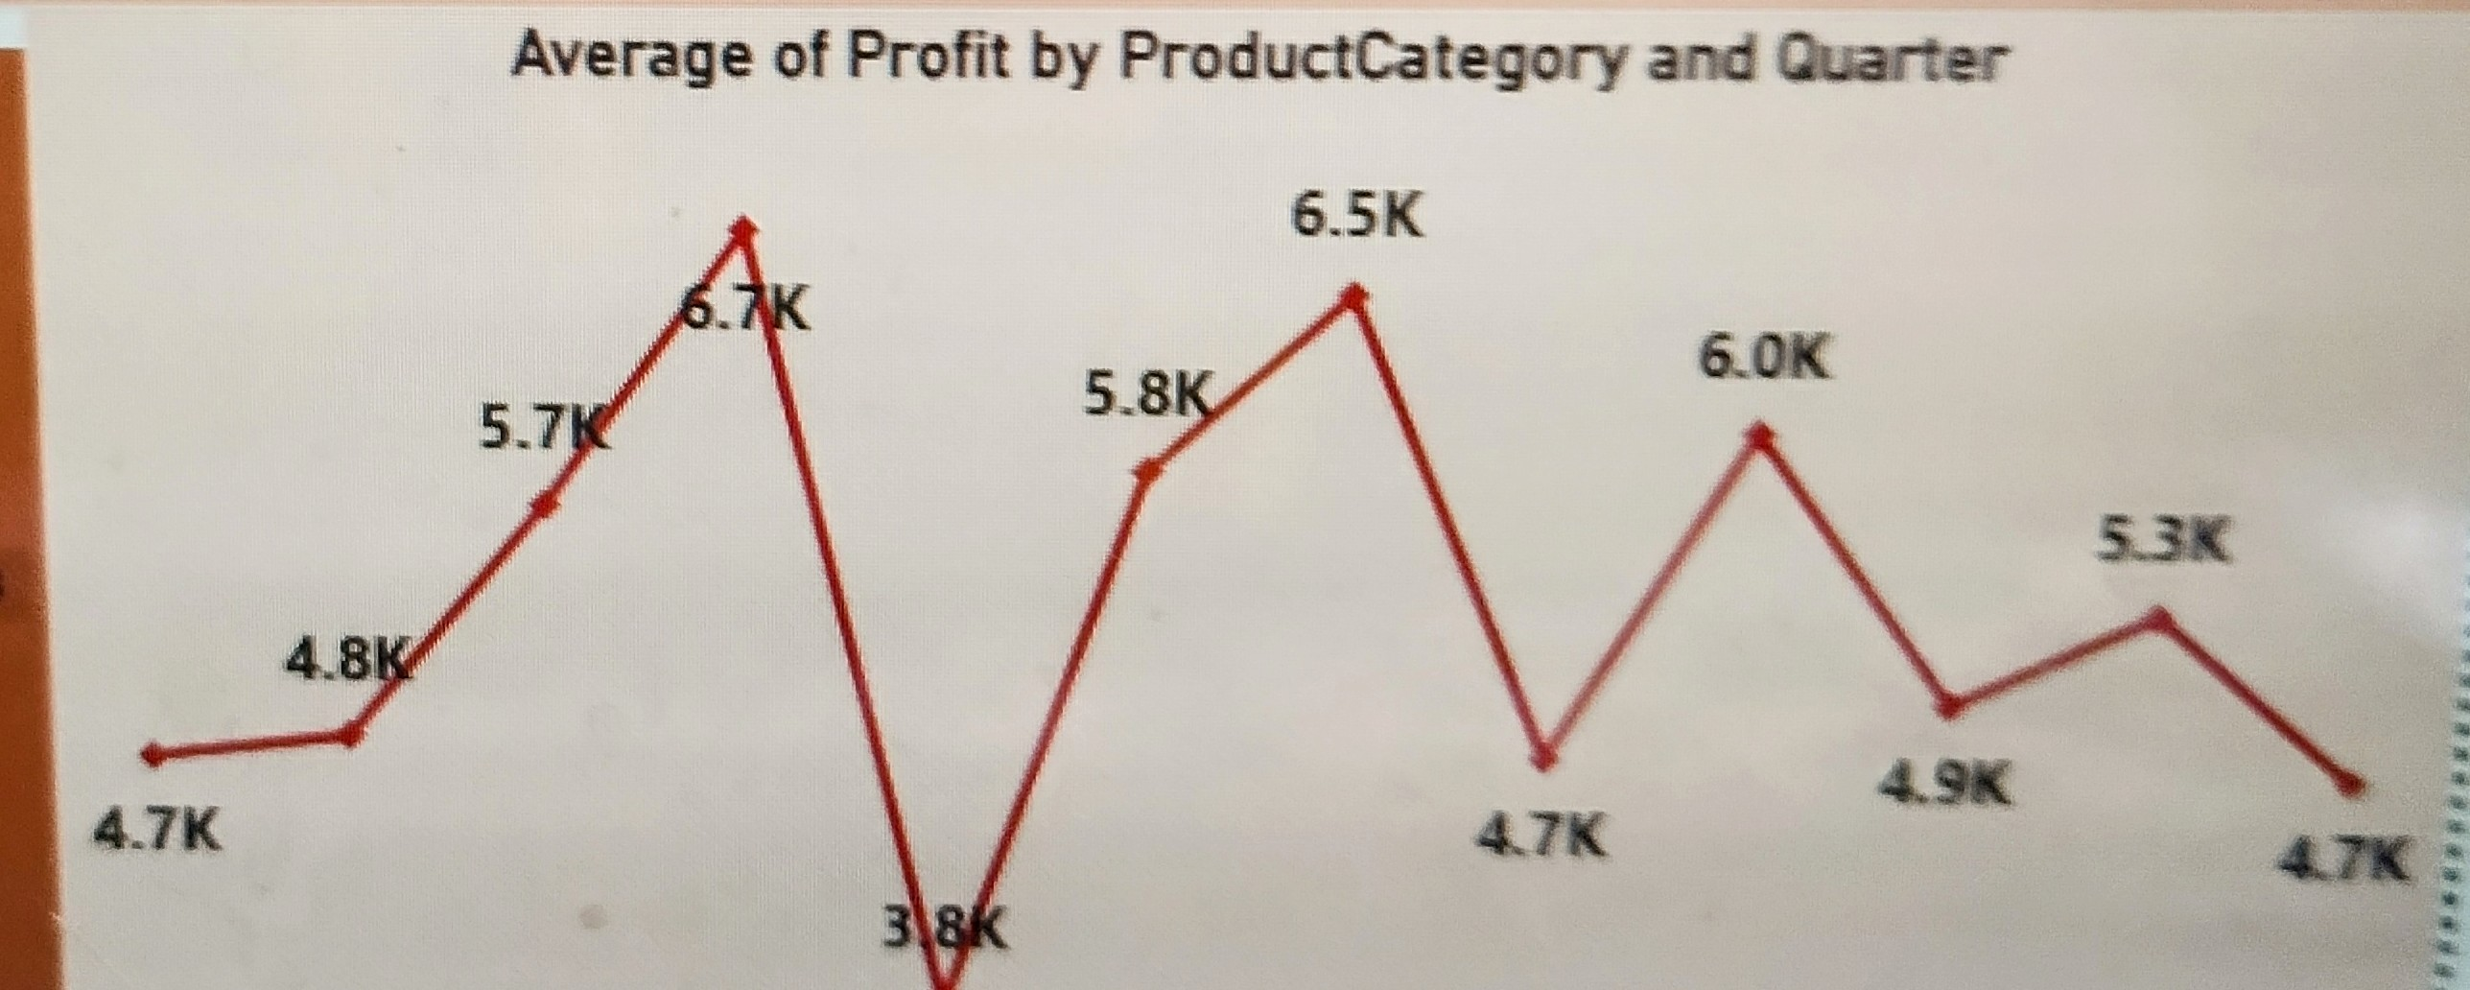
INSIGHTS
The first quarter had sensor having the highest average profit of 6.0k,Microchip comes 2nd with 4.7k and Robotics coming third pulling 3.8k.
The 2nd quarter had Robotics generated the highest average profit of 5.8k,sensor coming 2nd and microchip third with 4.8k.
The 3rd quarter witnessed Robotics generating 6.5k as the highest average profit followed by Microchip and the third is sensor
In the 4thquarter, Microchip had the highest average profit while
both Robotics and sensor garnered
the 2nd highest average profit

Slide 11
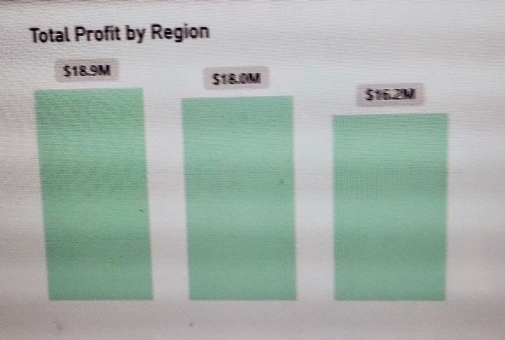
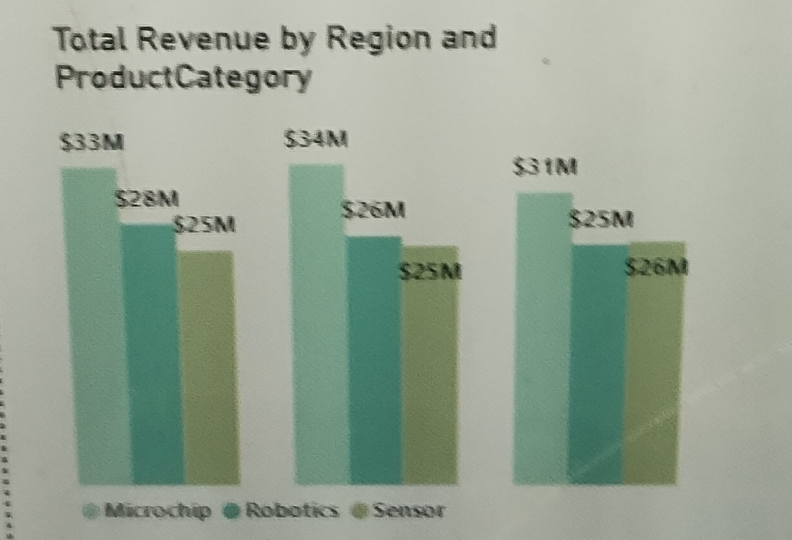
INSIGHTS
Asia –Pacific has the highest total profit in Robotics with $18.9M pulling $33M in total revenue in Europe and $34M total revenue in Asia- Pacific.

Slide 12
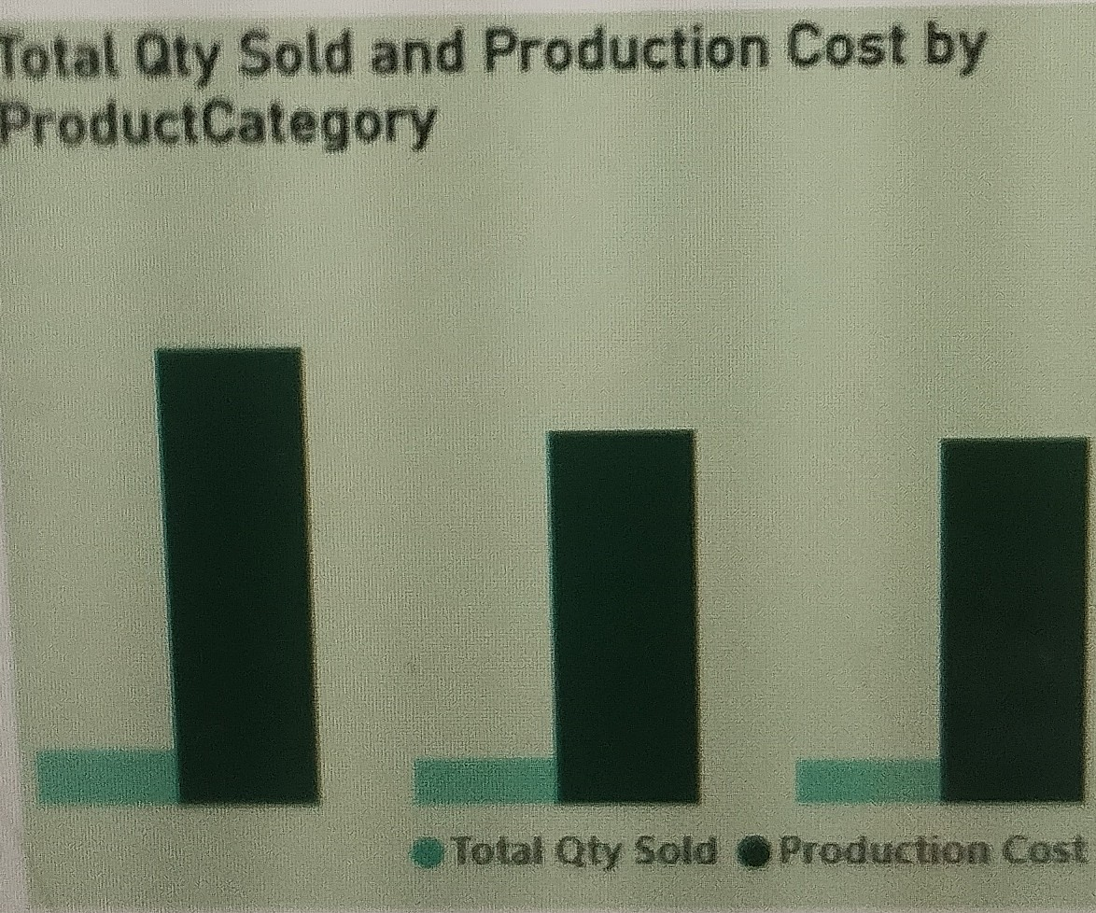
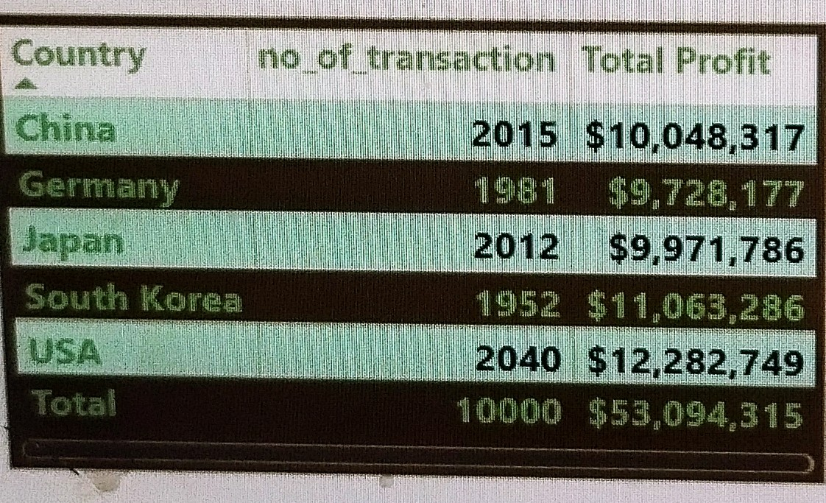
INSIGHTS
USA brings in the highest Total profit of $12M followed by South-Korea with $11M and China being the third in total profit of $10M

Slide 13
RECOMMENDATIONS h
Sales Performance Analysis
Customer Analysis
Inventory optimization
Microchip should be encouraged to be produced more as it has the highest revenue in Product category
Product name 1315 should be produced more as the production cost is the least in the Top 3 most expensive product to produce leading to the highest total profit by product name,
Product name 1100 should be reduced or eliminated in its product as it is not giving a good profit,
Product name 1469 should be encouraged to be produced more as it gives the 2nd highest in total profit
As USA is bringing the highest revenue in Industrial, they should channel their production in the sector while investing in Consumer Electronics as Japan is the best place to go. Discount should be given to USA so as to boost their sales in that sector.
More Microchip production should be channeled to Japan and South- Korea to boost their sales in that country.
Those products that are incurring losses in their sales should be annexed to those bringing high sales in their quarters.
The production of more Robotics should be encouraged as it brought the highest average profit in all the quarters followed by Microchip and sensor should be considered last in tits production or at most be reduced in its production.

Slide 14
RECOMMENDATIONS h
Profitability analysis
Market expansion opportunities
Market expansion
Opportunities contd
Majorly, Increased investment in industrial sector should be emphasized thereby reducing the production cost of Automotive as this will increase the total profits & revenue for Industrial sector.
Microchip production can be increased in regions like Asia-Pacific and Europe.
To raise the total profit of Microchip for North- America discount in form of buy two(2) and get one(1) free can be offered to them to boost their profit
For Robotics they can invest more in Asia –Pacific as it brings the 2nd highest profit.
As USA has the highest profit a market expansion is expected to be set up here.

Slide 16
